Slide 1
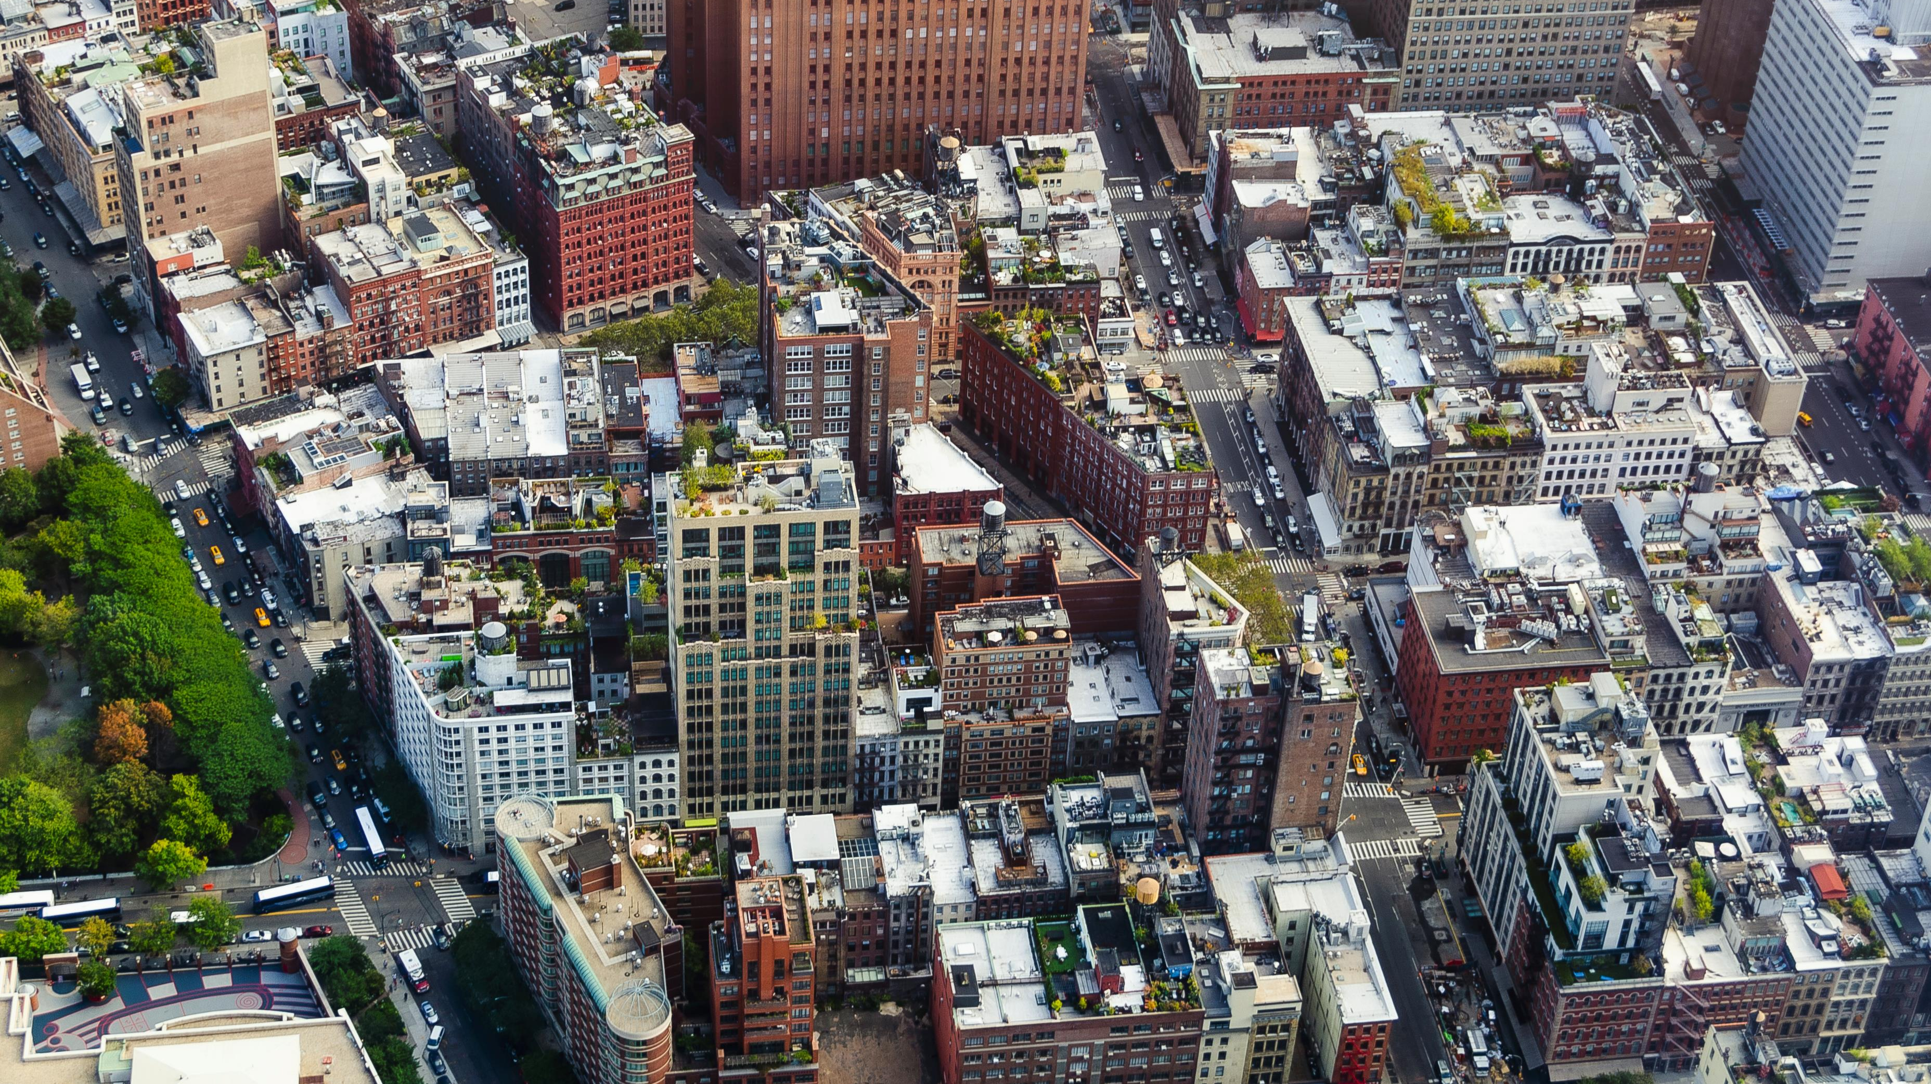
Detection of Cool Roofs in New York City Using Image Segmentation
John Hocknell | CUNY Hunter College
Mentored by Maddalena Romano | NYC Department of Transportation
Notes:
Picture credit: https://flic.kr/p/2hHVds9

Slide 2

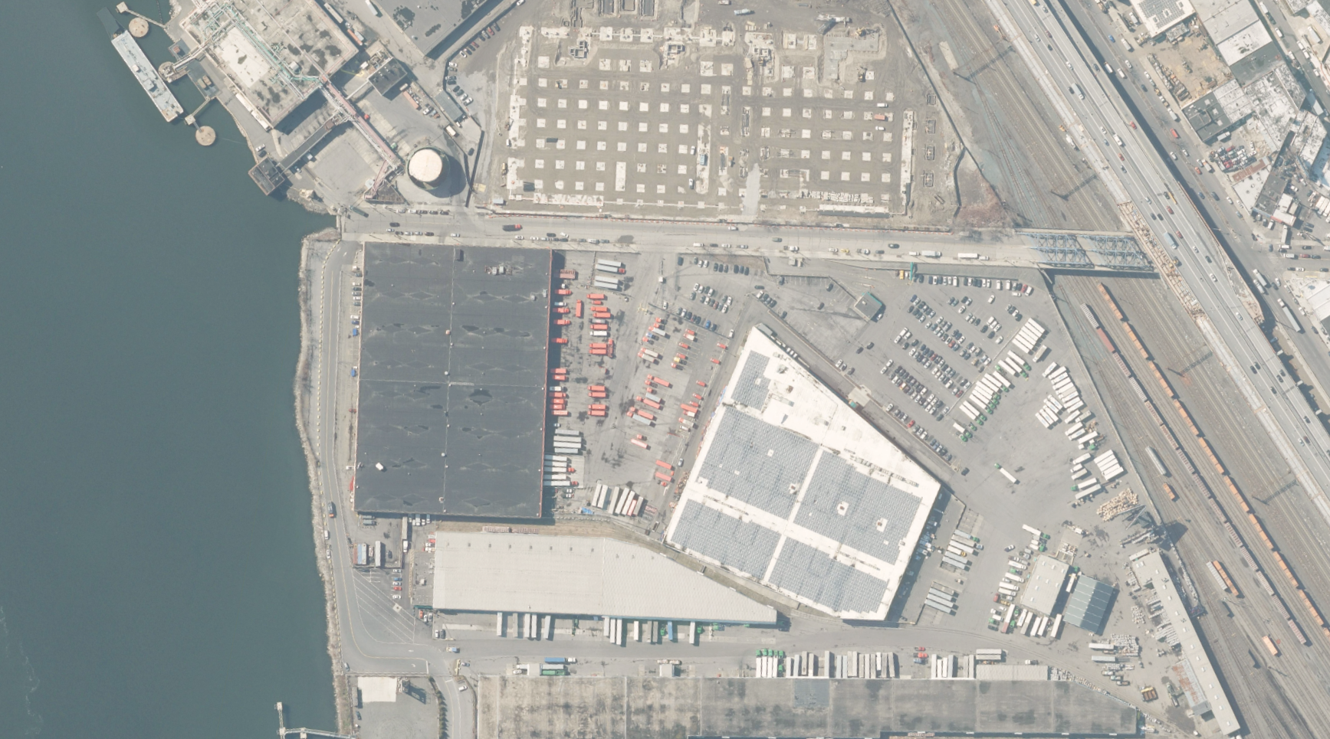


Cool roofs, or high albedo roofs, reflect more solar radiation
Low albedo roofs absorb more solar radiation

Slide 3
Project Goals
Classify the albedo of rooftops using machine learning
Quantify the change in albedo and associated energy savings

Slide 4
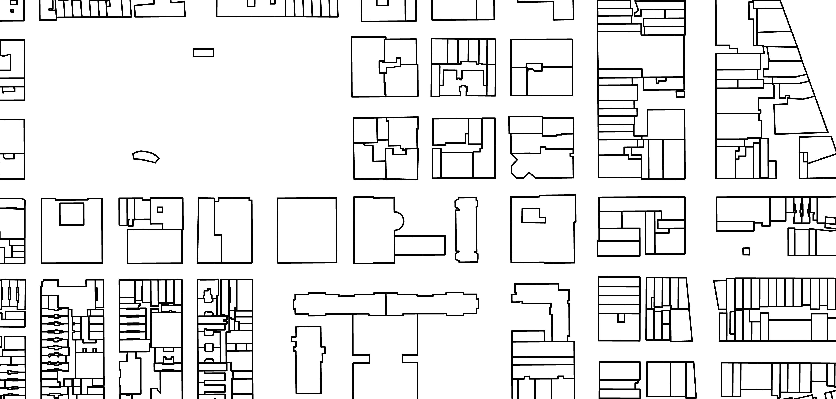
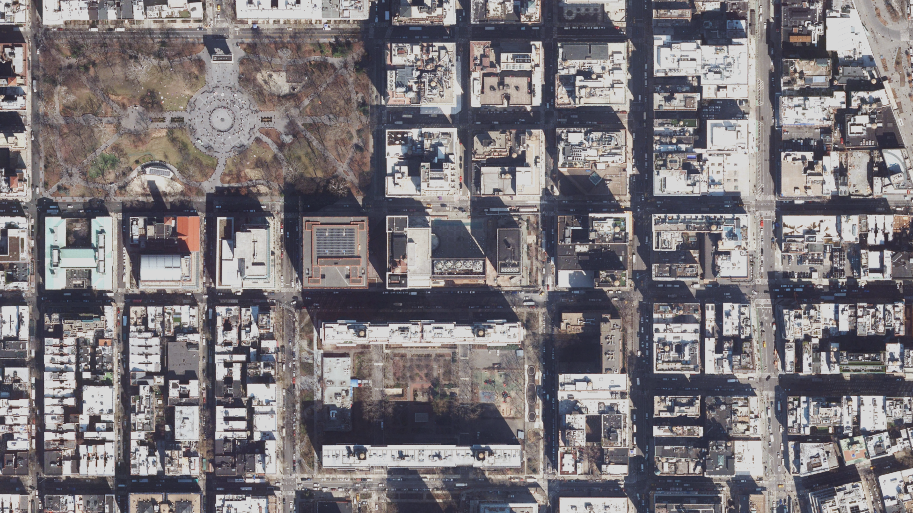
Data Sources
2022 Orthoimagery
Building Footprints

Slide 5
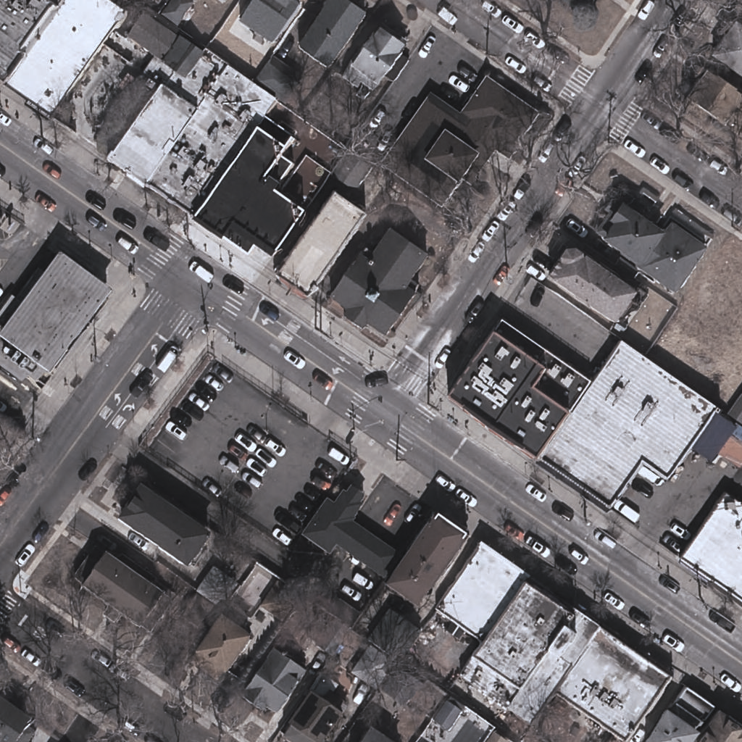
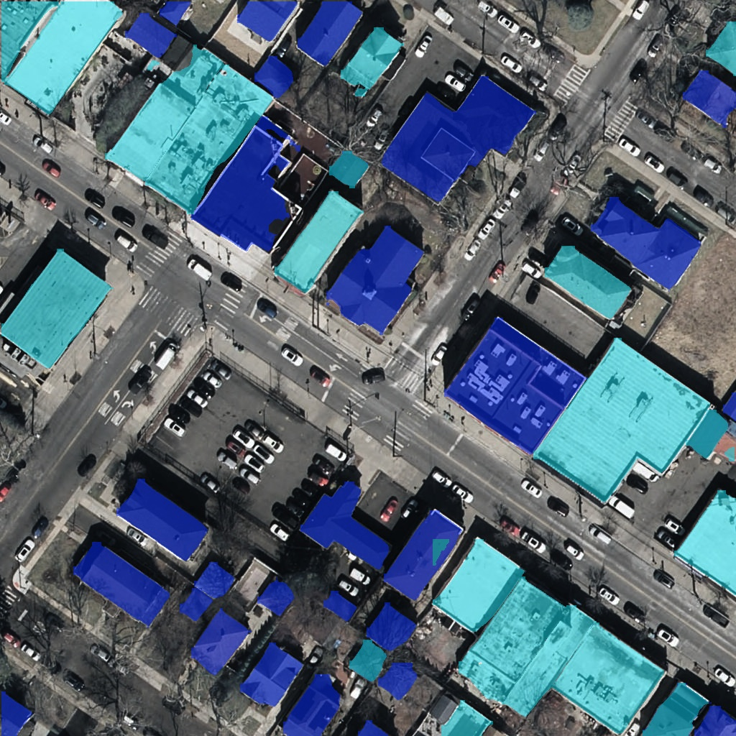
Image Segmentation
Identifies and segments individual occurrences of an object
Outputs a mask, bounding box, and label for every prediction
Warm roof
Cool roof
Input
Output

Slide 6



Tech Stack
rasterio
pyshp
shapely
pyyaml
geopandas

Slide 7

Methodology
Classify albedo
Filter building footprints
Classify roof albedo
Create a custom dataset
Train the model
Make inferences
Notes:
Filter the building footprints dataset
Calculate the albedo from the orthoimagery and find the mean albedo for each building polygon.
Split the orthoimagery into smaller images and split the building albedo polygon layer accordingly.
Create a custom dataset by converting the polygons to annotations and splitting the images into train, validation, and test sets.
Train the YOLOv11 instance segmentation model on the custom dataset.
Use the trained model to make inferences on new orthoimagery.

Slide 8

Methodology
Quantify changes
Geocode the inferences
Repeat process for a previous year
Compare albedo change
Calculate change in savings

Slide 9

Demonstration
Demonstration
Follow along using the QR code or link:
github.com/johnhocknell/cool_roofs_detection

Slide 10
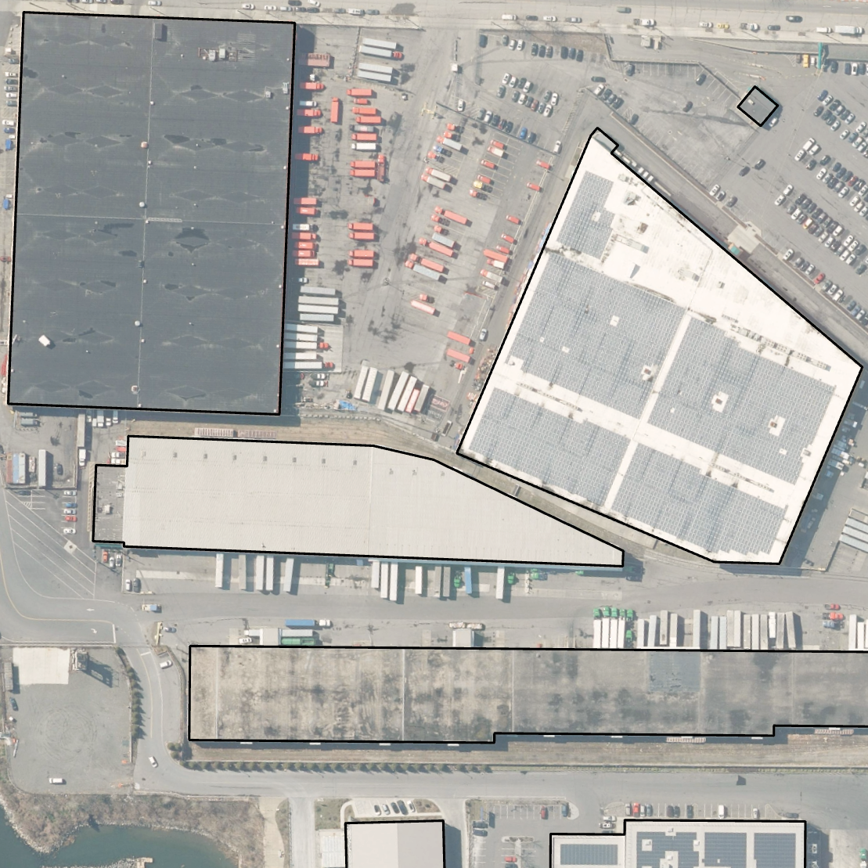
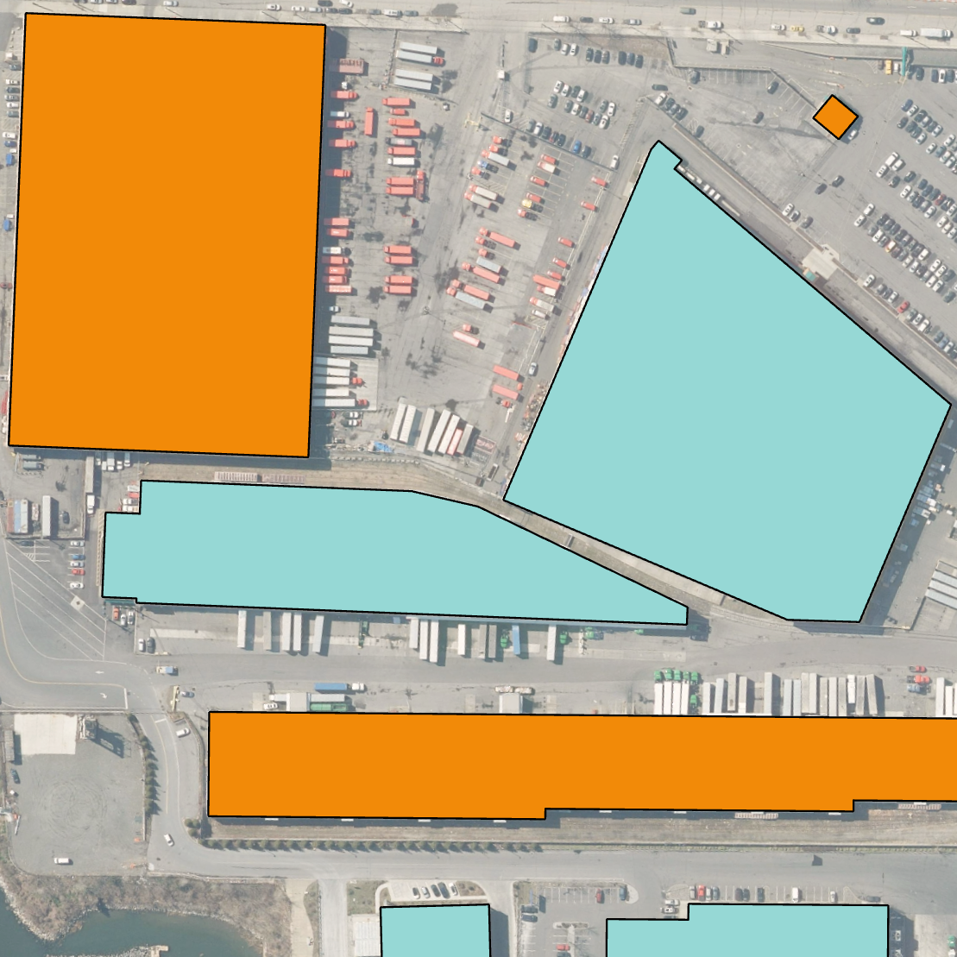


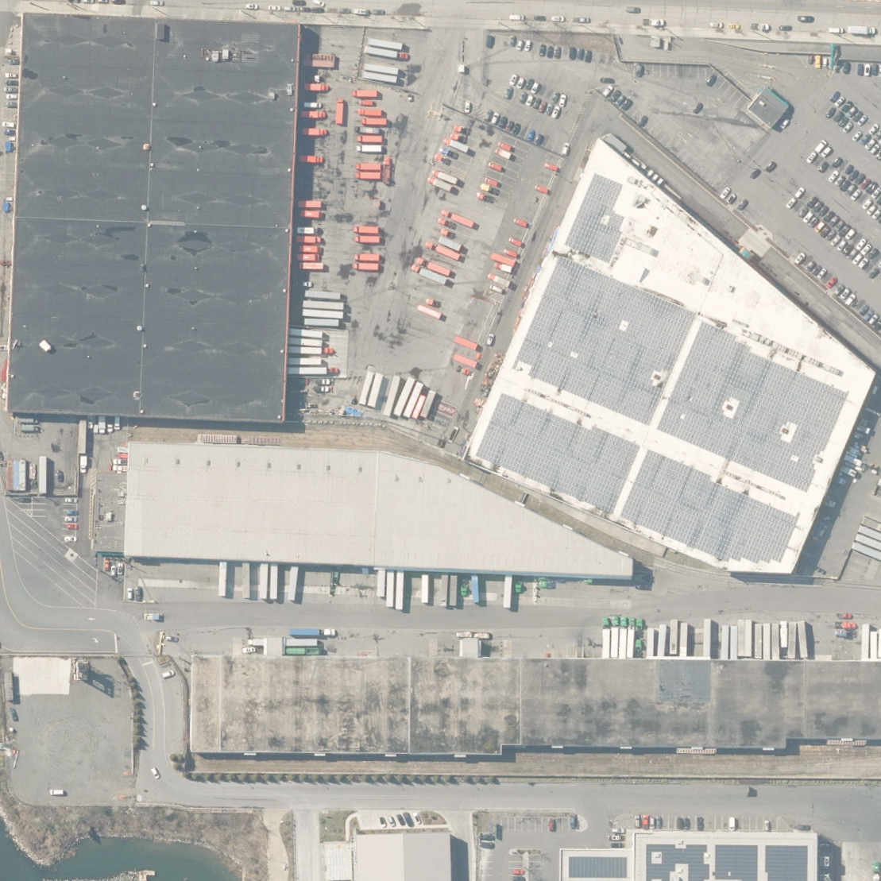
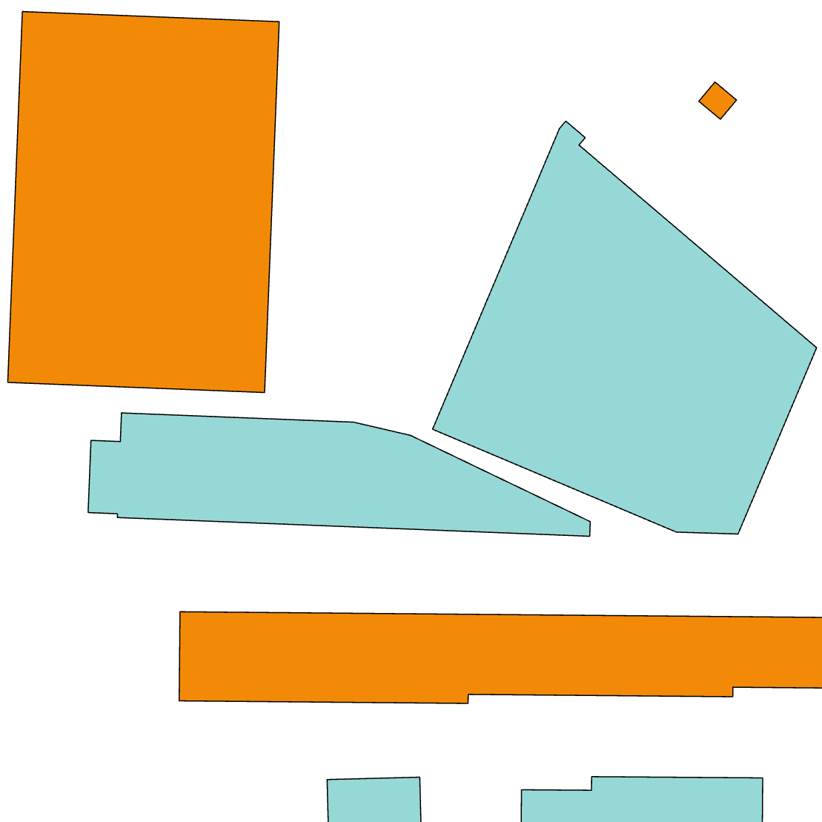
Calculate albedo and classify roofs
Warm roof
Cool roof
Custom training dataset
Images
Labels

Slide 11

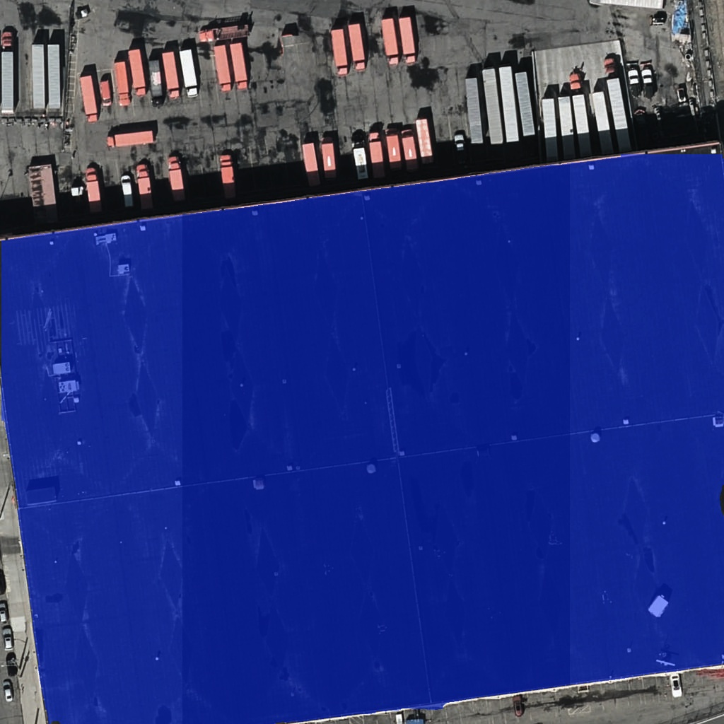
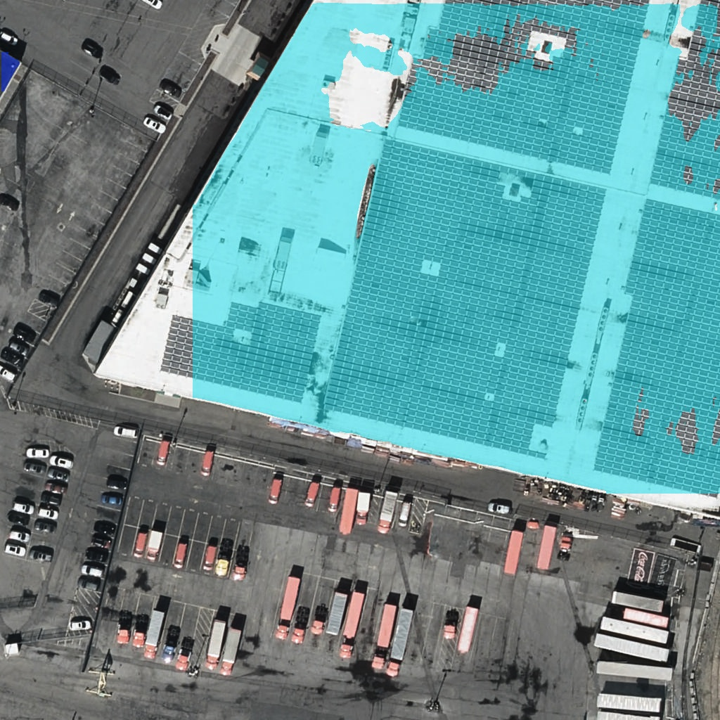
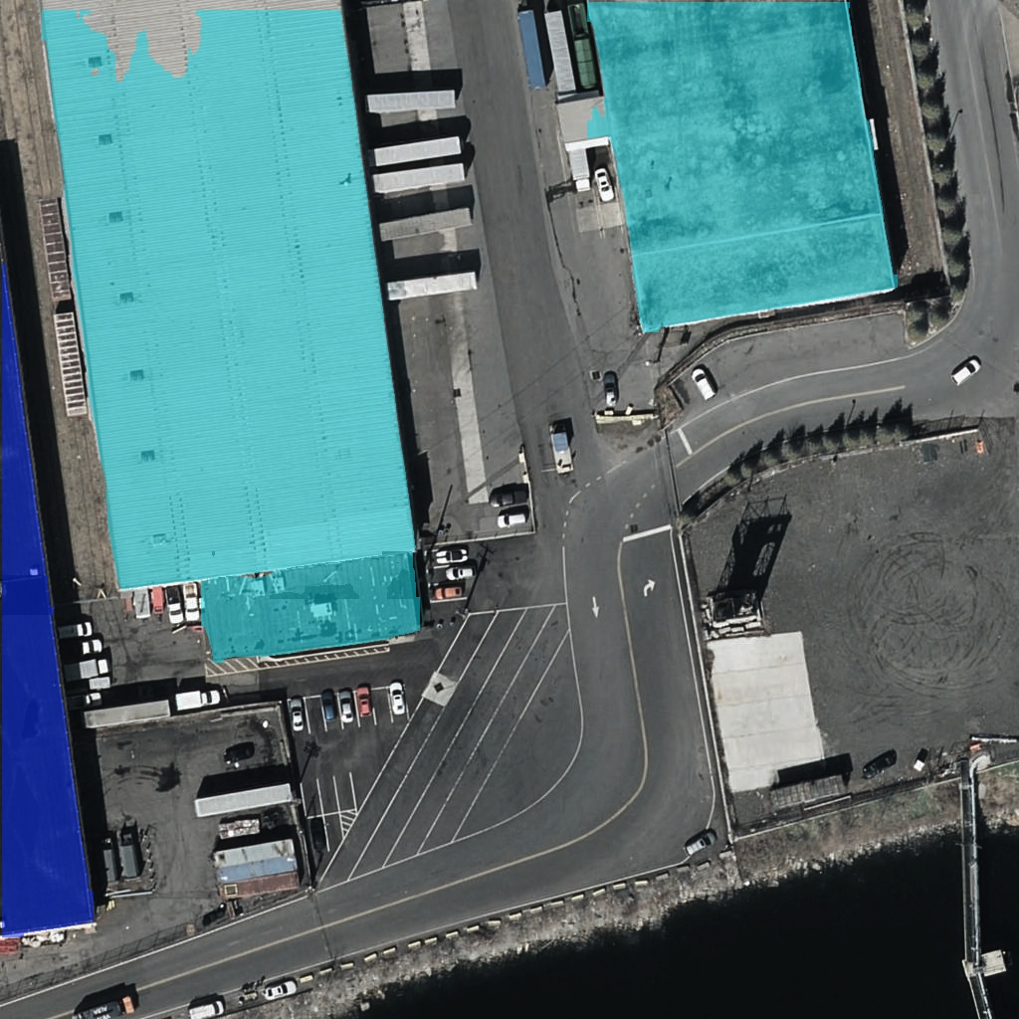
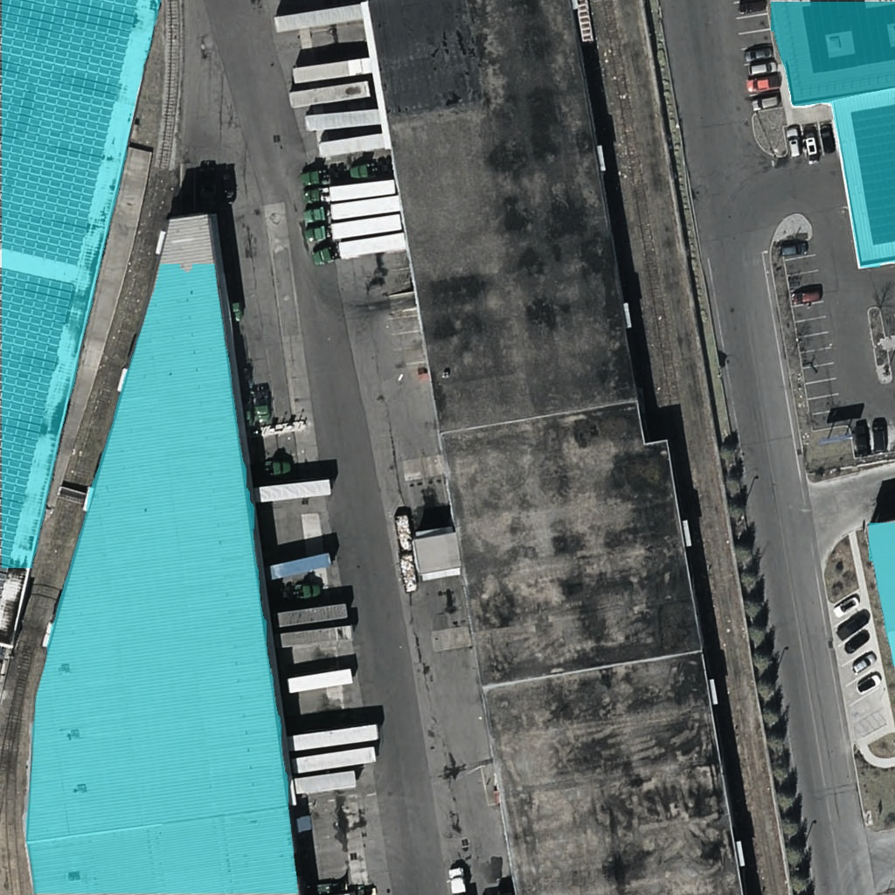
from ultralytics import YOLO
# Load a pre-trained YOLO image segmentation model
model = YOLO("yolo11n-seg.pt")
# Train the model using the custom dataset
results = model.train(data = "path/to/custom_dataset")
# Use the trained model to predict rooftops on images
results = model("path/to/image")

Slide 12
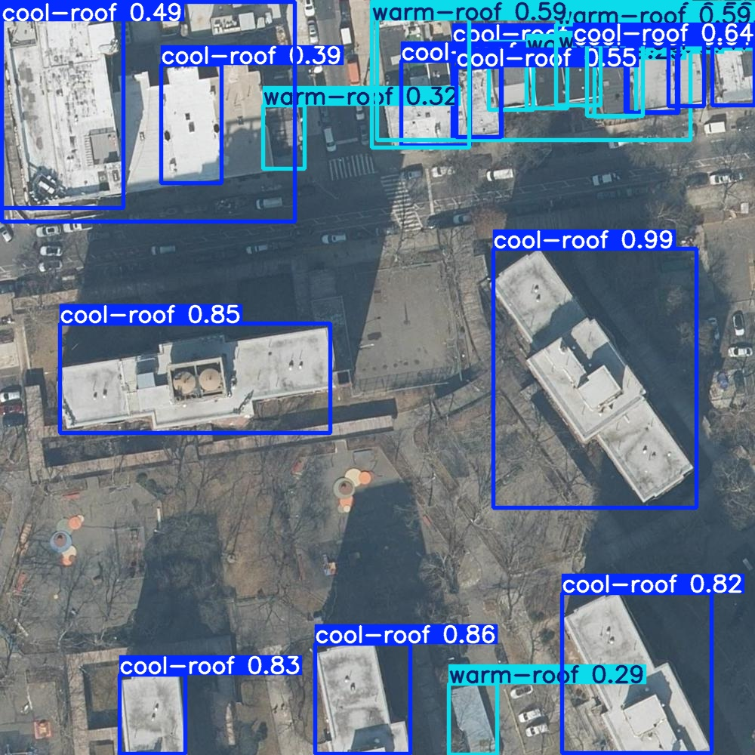
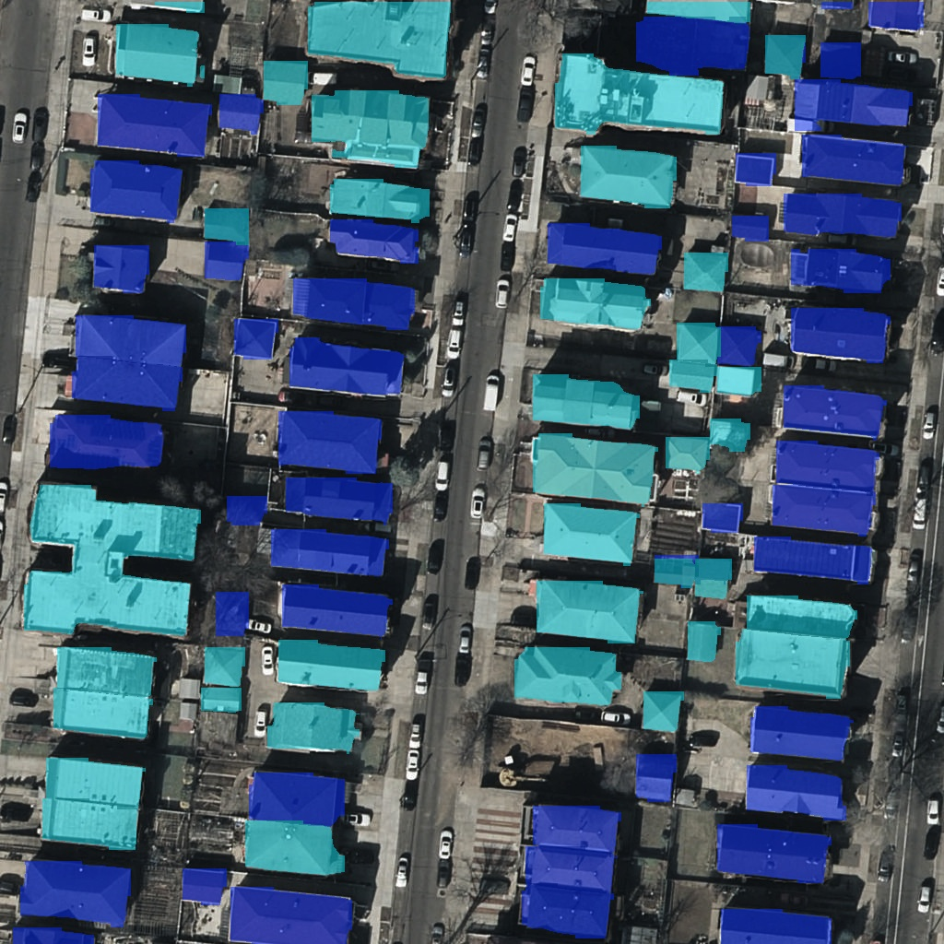
Model Results
Bounding box predictions and confidence scores classified by roof type
Mask predictions classified by roof type

Slide 13
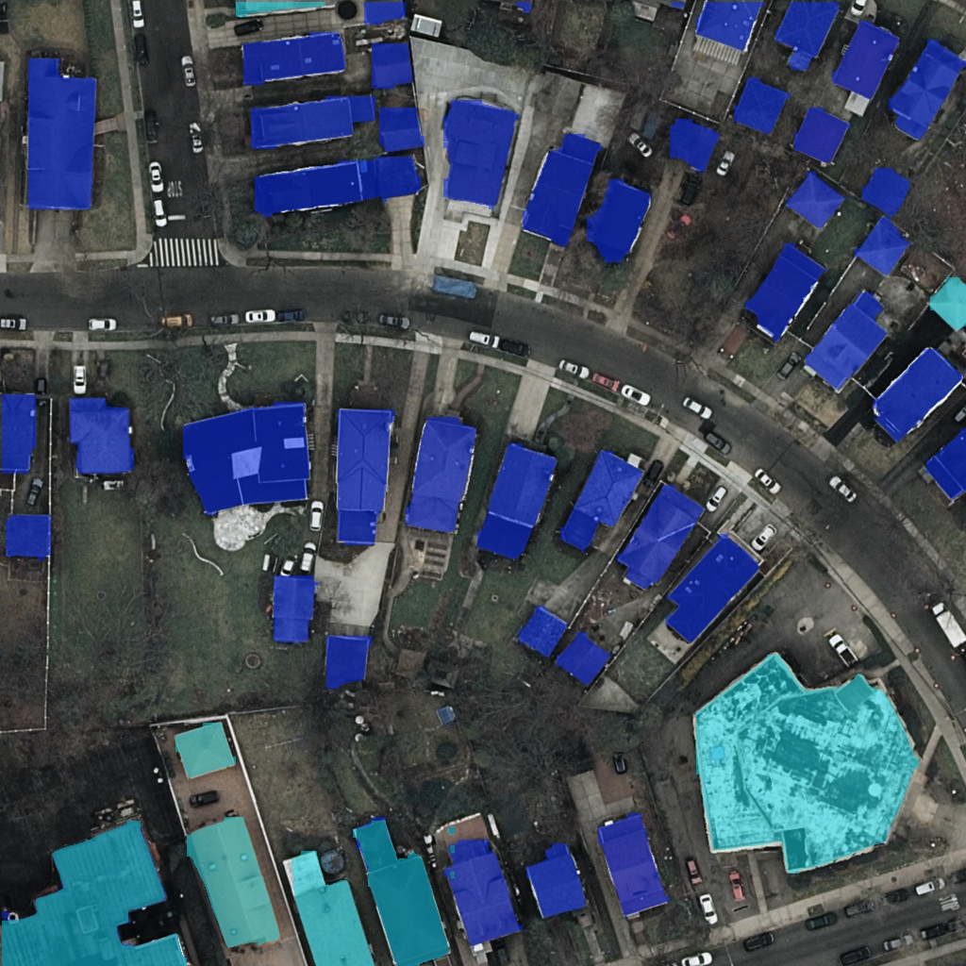
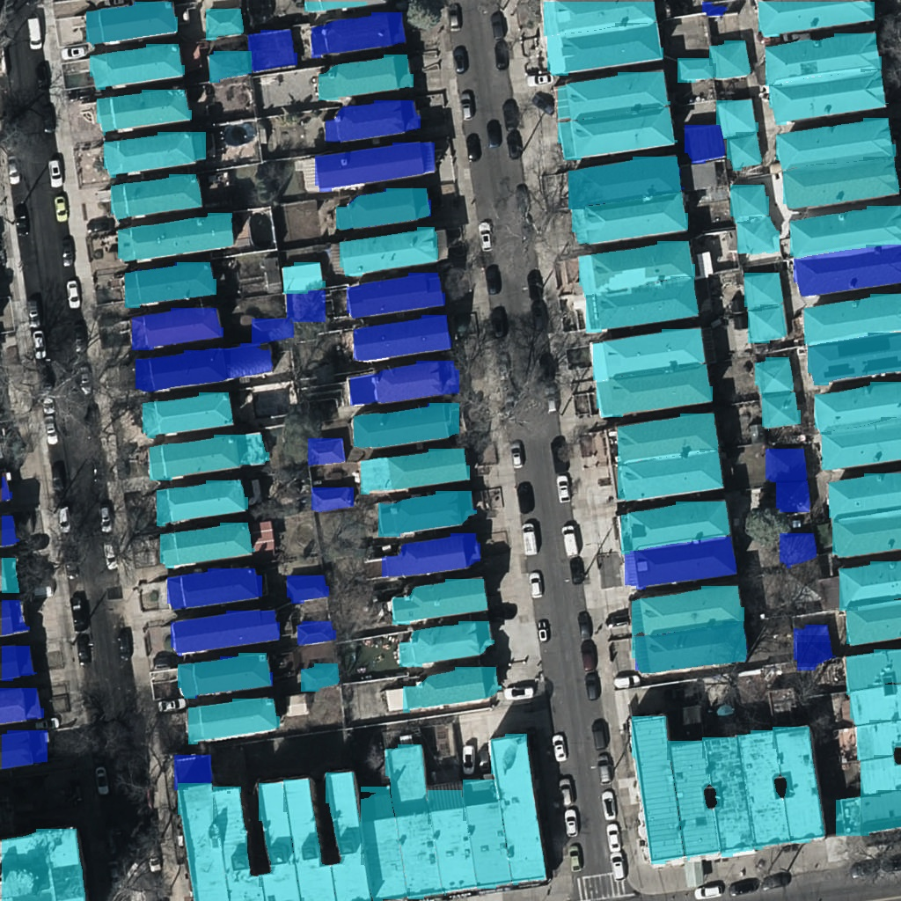
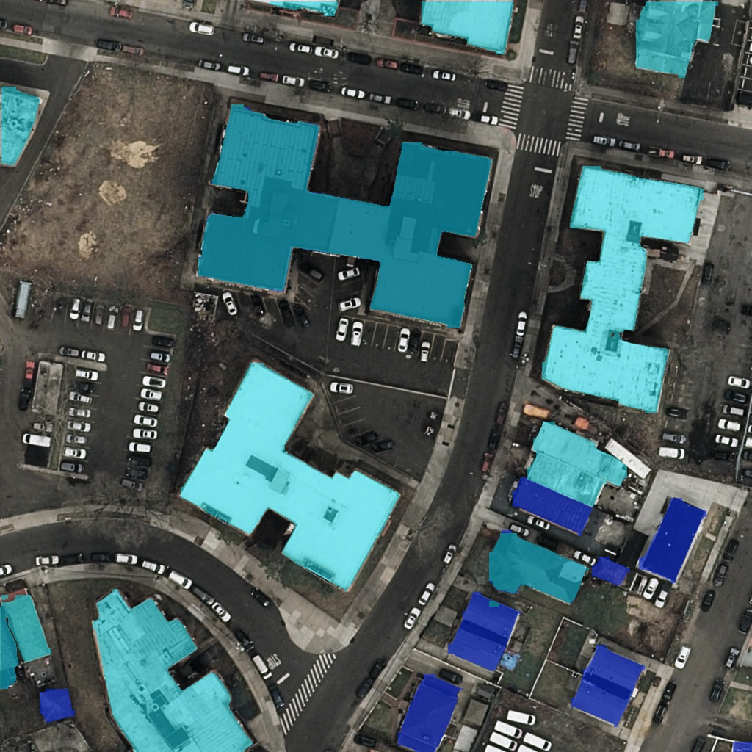
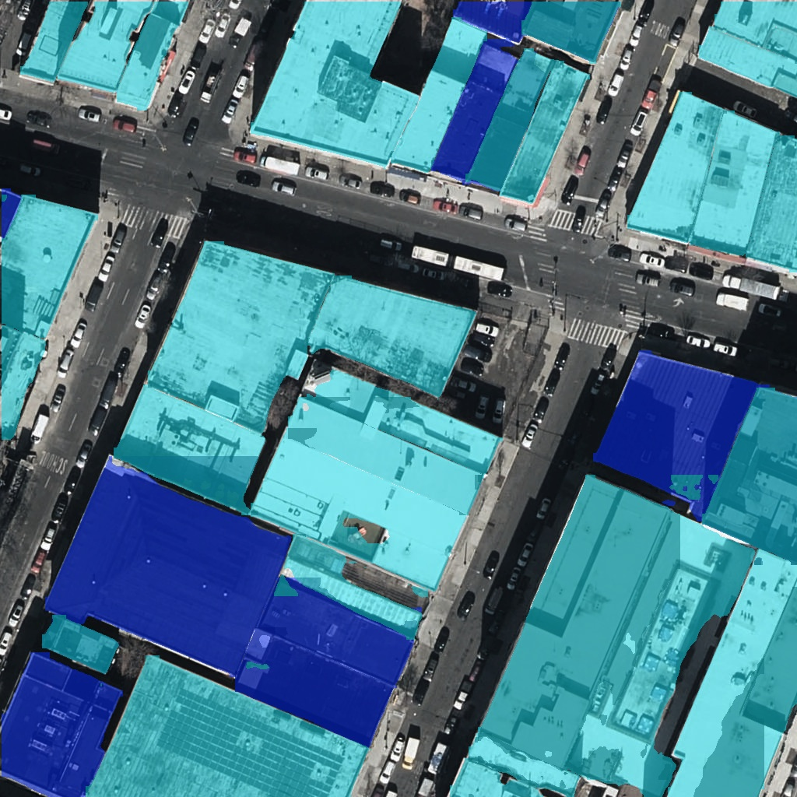
Model Results
Performs best on:
small to medium-sized rooftops
irregularly shaped buildings
Struggles to accurately mask underrepresented roof types from:
Large buildings
Warehouses
Airports

Slide 14
Future Research
Improving the model
Quantifying changes in albedo
Translating this into energy savings
Notes:
Results from quantifying changes in albedo and savings
Year to year change in albedo
Translating this into energy or cost savings

Slide 15
References
Building Footprints - Office of Technology and Innovation (OTI) - NYC OpenData
Orthoimagery - Discover GIS Data NY
NYC CoolRoofs Program Participants - NYC Emergency Management
Cool Roofs in a Warm City - Hunter College and NYC Mayor's Office of Climate & Environmental Justice
NYC Cool Roofs Dashboard - Hunter College and NYC Mayor's Office of Climate & Environmental Justice
NYC CoolRoofs - NYC Business

Slide 16


Thank you!
Contact me at:
john.hocknell58@myhunter.cuny.edu
Check out the repository for this project using the QR code or at:
github.com/johnhocknell/cool_roofs_detection

